Slide 1
ELECTRONIC CRACK DETECTION AND LOCALIZATION SYSTEM
Presented by:
AMARNATH A (TKM21EC024)
ANANDU VK (TKM21EC029)
RAHUL KUMAR BS (TKM21EC108)
SREEHARI R (TKM21EC127)
Guided by:
Prof. Anu Assis
Associate Professor
TKMCE

Slide 2
Contents
INTRODUCTION
LITERATURE REVIEW
PROBLEM DEFINITION
CHALLENGES
COMPONENTS
ARCHITECTURE
WORKING
PROCESS FLOW CHART
CIRCUIT DIAGRAM
RESULTS
CONCLUSION
FUTURE DEVELOPMENTS
REFERENCES

Slide 3
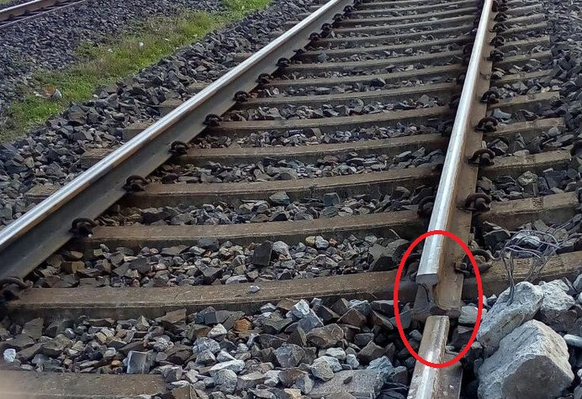
Introduction
Objective:
Today, we delve into an innovative approach transforming railway maintenance: the Electronic Crack Detection and Localization System. This system represents a pivotal advancement in railway safety and operational efficiency.
Importance:
Railways serve as lifelines for transportation globally, and ensuring their safety is paramount. Traditional methods of detecting track defects have limitations, often leading to safety risks and operational disruptions. The Electronic Crack Detection System addresses these challenges head-on.
Overview:
Throughout this presentation, we will explore the technology behind these systems, their operational benefits, successful case studies, and their integration with existing infrastructure. By the end, you'll understand how this cutting-edge technology can revolutionize railway maintenance practices.
Figure 1: Railway Crack

Slide 4
Literature Review
ARTICLE READ | INFERENCE FROM THE ARTICLE
Designing of Improved Monitoring System for Crack Detection on Railway Tracks Author- Nilisha Patil1, Dipakkumar Shahare1, Shreya Hanwate1, Pranali Bagde1, Karuna Kamble1, Prof. Manoj Titre2. Published-April 2021 | To overcome the issue of faults in tracks and identify the moving object or animal on the tracks, we learned an automated system based on a microcontroller and sensors. An autonomous robot with PIR and Ultrasonic sensors, coupled with GPS and GSM, is designed to provide real time alerts.
Detection of Crack in Railway Track using Ultrasonic Sensors Author- Anushree B.S, Priyasha Purkayastha, Anjali Girgire, Anjana K, Ruma Sinha. Published-May 2017 | The paper proposes a crack detection system, which detects the crack without human intervention and transmits the location of the fault to the authorized personnel via GSM. Using this technique, cracks can be detected both during the day and at night, revealing the precise location of the fault.

Slide 5
Literature Review
ARTICLE READ | INFERENCE FROM THE ARTICLE
Automatic Railway Track Crack Detection System Author- Rahul Singh, Leena Sharma, Vandana Singh, Vivek Kr. Singh. Published- May 2020 | The goal is to develop a railway crack detection system (RCDS) employing an ultrasonic sensor, the global system for mobile communications, the GPS and an Arduino-based module, whose implementation will provide a cost-effective method for detecting cracks in the tracks and thereby avoiding train derailments.
Railway Track Crack Detection Author- Arun Kumar R, Vanishree K, Shweta K, Nandini C, Shweta G. Published2020 | This project discusses railway track crack detection using sensors and is a dynamic approach which combines the use of a GPS tracking system to send alert messages and the geographical coordinate of the location. Arduino microcontrollers were used to control and coordinate the activities of this device. Designing the railway crack detection system employing ultrasonic sensors is the main goal of the project.

Slide 6
Problem Definition
To develop an Electronic Crack Detection And Localization System For Railway Lines using sensors and Arduino Nano BLE which includes GPS location

Slide 7
Challenges in Railway Maintenance
Current Challenges
Crack Detection Limitations:
Manual Inspection: Relies heavily on visual inspections, which are prone to human error and can miss hidden cracks.
Frequency: Irregular inspection schedules may lead to undetected cracks until they pose a significant risk.
Safety Concerns:
Risk of Failures: Undetected cracks can lead to derailments or other accidents, endangering passengers, crew, and cargo.
Regulatory Compliance: Strict safety regulations require continuous monitoring and prompt maintenance of railway tracks.
Infrastructure Aging:
Track Wear: Continuous use and environmental factors lead to wear and tear, increasing the likelihood of cracks and defects.
Maintenance Backlogs: Managing extensive railway networks with aging infrastructure requires efficient maintenance strategies.
Environmental Factors:
Weather Conditions: Extreme temperatures, moisture, and other environmental factors contribute to track degradation and crack formation.
Geographical Challenges: Tracks in remote or inaccessible areas pose logistical challenges for timely inspections and repairs.

Slide 8
Components
HARDWARE COMPONENTS
ARDUINO MICROCONTROLLER
POWER SUPPLY
ULTRASONIC SENSOR
GSM MODULE
GPS MODULE
JUMPER WIRES
SOFTWARE COMPONENTS
ARDUINO IDE
EMBEDDED C
C PROGRAMMING

Slide 9
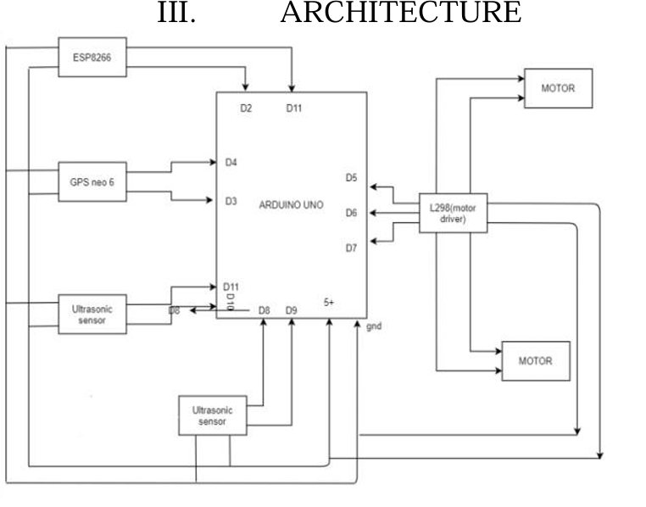
Figure 2: Architecture

Slide 10
Working
This project integrates ultrasonic sensors for crack detection and obstacle avoidance, controlled by an L298N motor driver. Upon detecting a crack (distance < 200 cm), the robot maneuvers autonomously—stopping, reversing briefly, turning left, then resuming forward motion.
Simultaneously, a GPS module tracks real-time coordinates, crucial for pinpointing crack locations. Detected coordinates are transmitted via a GSM module over cellular networks, sending SMS alerts with precise latitude and longitude to a designated phone number.
This autonomous operation enables immediate response to cracks, ideal for infrastructure inspection. Future enhancements could include additional sensors for accuracy, advanced navigation algorithms, optimized power consumption, and data logging for predictive maintenance, ensuring continual improvement and reliability in monitoring critical infrastructure.

Slide 11
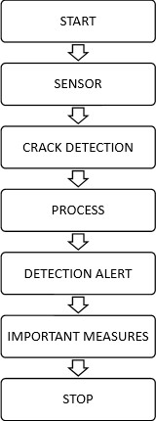
Process Flow Chart
Figure 3: Flow Chart

Slide 12
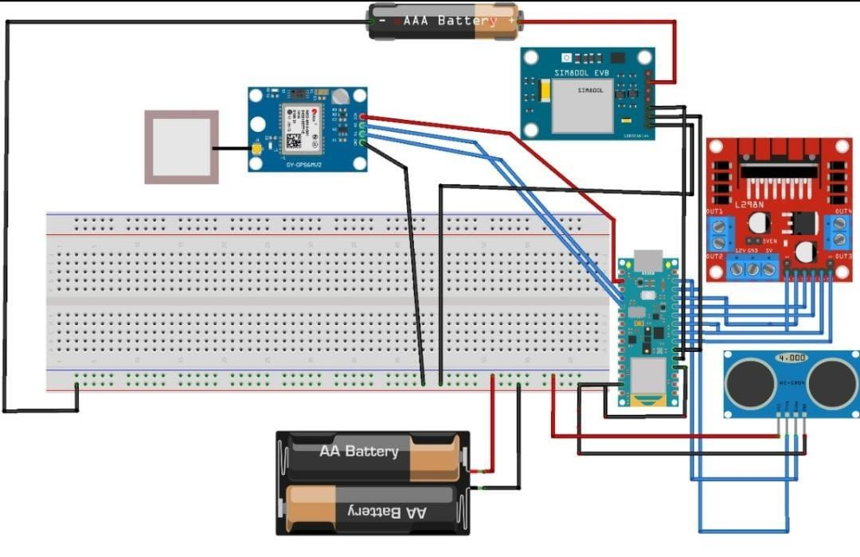
Circuit Diagram
Figure 4: Circuit Diagram

Slide 13
Results
Sensor Setup: Ultrasonic sensor detects cracks or obstacles < 200 cm.
Autonomous Navigation: Robot stops, reverses, turns left, then proceeds.
GPS Tracking: Provides real-time coordinates for crack location.
Reporting System: GSM module sends GPS coordinates via SMS.
Automation Benefits: Enables autonomous crack detection and reporting.
Future Enhancements: Include more sensors, advanced algorithms, power efficiency, and data logging for accuracy and maintenance improvement.

Slide 14
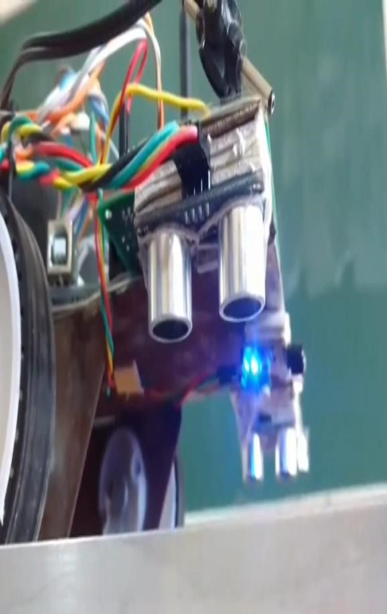
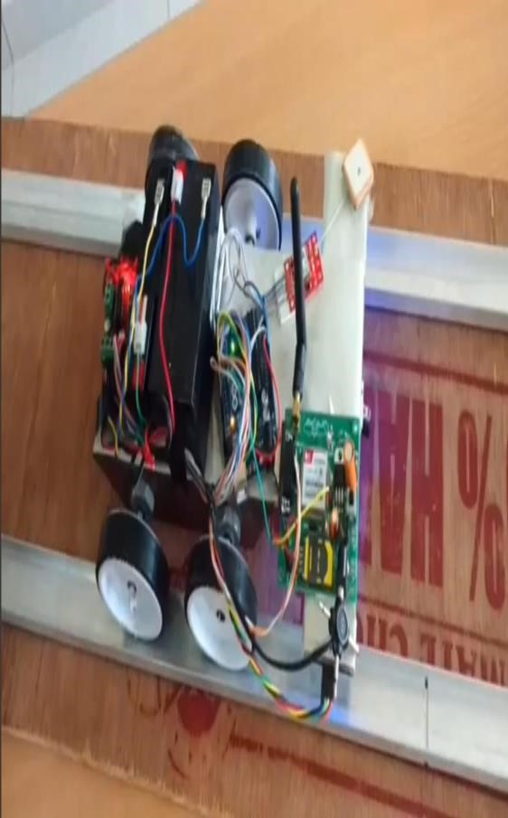
Figure 5: Crack Detection System

Slide 15
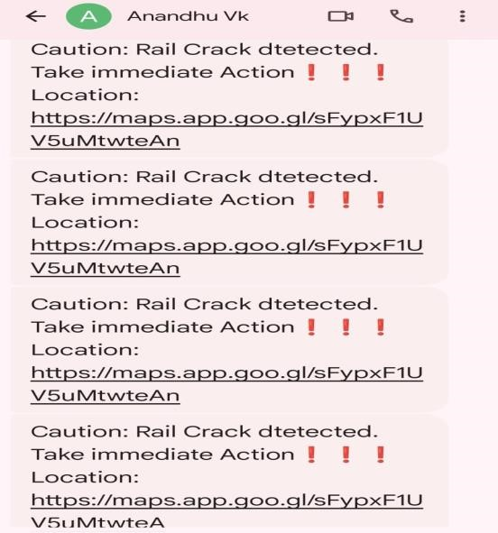
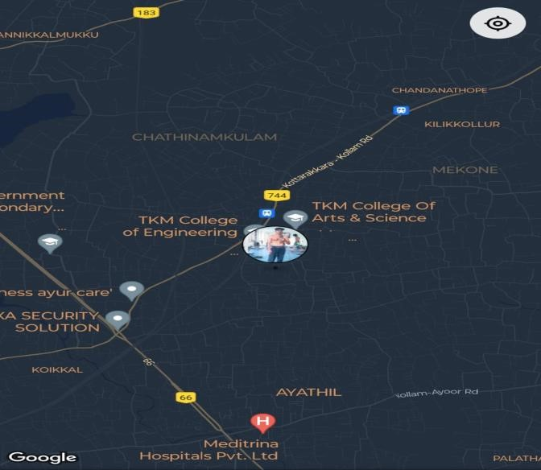
Figure 6: Notification received from the system

Slide 16
Conclusion
As per the study the existing systems are time consuming as well as uneconomical.
The proposed system is not only overcome these problems but also improve accuracy and crack detection in rails.
It is the most economical solution provided in order to achieve good results of railways of our country in order to minimize the stats of accidents caused.
There by possible to save precious lives of passengers and loss of economy. It also saves the time and money for identification of crack.

Slide 17
Future Developments and Trends
Technological Advancements
Sensor Innovations: Development of more sensitive and accurate sensors for detecting smaller cracks and anomalies.
Integration of AI and Machine Learning: Utilizing advanced algorithms to enhance crack detection accuracy and predictive maintenance capabilities.
IoT Integration: Incorporating Internet of Things (IoT) technologies for seamless connectivity and data exchange between sensors and control systems.
Enhanced Data Analytics
Predictive Analytics: Leveraging historical and real-time data to predict potential failures and optimize maintenance schedules.
Big Data Utilization: Analysing large datasets to uncover insights for improving track maintenance strategies and operational efficiency.
Automation and Robotics
Automated Inspection Systems: Implementing robotic platforms for autonomous track inspections, enhancing efficiency and coverage.
Drone Technology: Utilizing drones for aerial inspections of railway infrastructure, providing comprehensive visual data for analysis.

Slide 18
References
[1] A. Rizvi, P. Khan and D. Ahmad, "Crack Detection In Railway Track Using Image Processing", International Journal of Advance Research, Ideas and Innovations in Technology., vol. 3, no. 4, 2017.
[2] S. Srivastava, R. Chaurasia, S. Abbas, P. Sharma and N. Singh, "Railway Track Crack Detection Vehicle", International Advanced Research Journal in Science, Engineering and Technology, vol. 4, no. 2, pp. 145-148, 2017. [3]
[3] K.Bhargavi and M. Janardhana Raju "Railway Track Crack Detection Using Led-Ldr Assembly“, International Journal of Advanced Research in Electronics and Communication Engineering (IJARECE), vol. 3, no. 9, pp. 1230-1234, 2014.
[4] B. Siva Ram Krishna, D .Seshendia, G. Govinda Raja, T Sudharshan and K. Srikanth, "Railway Track Fault DetectionSystem By Using IR Sensors And Bluetooth Technology", Asian Journal of Applied Science and Technology (AJAST), vol. 1, no. 6, pp. 82-84, 2017.
[5] P. Navaraj, "Crack Detection System For Railway Track By Using Ultrasonic And Pir Sensor", vol. 1, no. 1, pp. 126-130, 2014.
[6] D.Narendhar Singh and D. Naresh, "Railway Track Crack Detection And Data Analysis", vol. 5, no. 4, pp. 1859-1863, 2017. [7] [7] 2017. Available: https://m.timesofindia.com/india/586 train- accidents-in-last-5-years-53-due-to derailments/amp_articleshow/60141578.cms.

Slide 19

THANK
YOU

